Slide 1
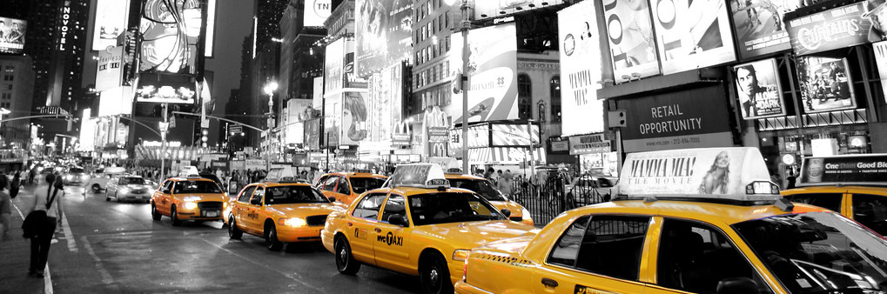
NYC Yellow Taxi Tipping
How does trip-size and friction affect tipping behavior in NYC yellow taxis?

Slide 2
NYC Yellow Taxi trips: Data & Scope
Dataset: NYC Yellow Taxi trips (Jul – Sep 2025)
Enrichment: Taxi Zones (PU/DO zones) + BID boundaries (zone overlap %)
Focus: tipping behaviour in card paid trips
Unit of analysis: one record = one trip
Output: Tableau Story (Hypothesis tests)

Slide 3
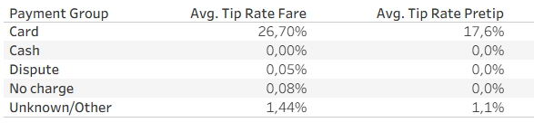
NYC Yellow Taxi trips: Data & Scope
From raw to analysis sample
  Raw trips loaded: ~ 11.7 million rows
  Analysis sample: ~ 6.8 million rows (-42 %)
Key Metrics
  Tip probability (%) = share of trips with tip_amount > 0
  Tip % of fare = tip_amount / fare (fare = pre-tip total in this analysis)
  Tip % of fare (P99 capped) = used to reduce extreme outliers ans stabilizie averages
Payment Scope
  Cash tips are not reliably captured → excluded to reduce measurement bias
Cash tips often appear as 0 in TLC records

Slide 4
Analysis flow & hypotheses
Tipping mechanics → Hypothesis tests → Conclusion
Research question: How does trip context — especially trip size and friction — shape tipping behavior
Hypothesis:
  H1 Tipping mechanics (trip size)= small fares follow minimum tip-pattern which inflates tip
  H1 Stress/Friction = higher minutes-per-mile reduces probability of tipping
  H3 Airport = Airport (JFK/LGA) trips tips more than non-airport trips
  H4 BID exposure= higher BID overlap at dropoff → higher tipping

Slide 5
Let‘s Continue in Tableau

Slide 6
Key Findings
(H1) Tipping Mechanics
Trip size is the key confounder. Small fares show step-like tipping (~$2), which inflates tip % of fare on small trips – so comparisons must be made within fare bins
H2 Stress/Friction
Stress reduces tipping probability consistently, even within trip-size buckets.
Tip % of fare moves less ; the clearer signal is whether people tip or not.
H3 Airport
Airport uplift is conditional. Overall averages can look flat or even lower because airport trips have much higher fares, but within fare bins airport trips often show higher tipping probability.
H4 Business improvement districts
BID is not dose–response. Increasing BID overlap does not steadily increase tipping; the pattern is closer to a threshold effect (0% vs >0%), strongest from $30–50 upward, and more consistent at dropoff than pickup.

Slide 7
So what? Practical implications
First: Guardrail
  Always control for fare (trip size) when comparing groups
Second: Reduce friction where possible
  stop-and-go conditions lower the likelihood of tipping (tip probability (%))
Third: Separate decision from amount
  Report tip probability and tip % of fare among tipped trips separately—friction mainly changes the share of zero-tip trips
The best lever isn’t where, it’s how the ride feels, and which segment the trip is in.

Slide 8
Resultstable
Hypothesis | Metric Focus | Result | Observation | Implication
Trip Size /tipping mechanics | Tip % of fare | Confirmed (measurement effect) | Tip metrics change strongly with fare size; low fares behave non-linearly | Control for fare bins before comparing contexts.
Stress / Friction | Tip prob. (%) | Supported | As minutes-per-mile increases, tip probability declines (holds within fare buckets). | Friction mostly affects whether people tip, not the % when they do.
Airport | Tip prob.(%) Tip % of fare | Conditional | Overall looks flat/lower; within fare bins, airports often tip higher in mid/high fares. | Airport uplift is segment-specific, not universal.
BID eposure | Tip probability (%) Tip % of fare | Threshold, not dose-response | Main split is no exposure vs some exposure; more overlap doesn’t reliably add more. | BID is a context marker; “more overlap” isn’t a scalable lever.

